Slide 1
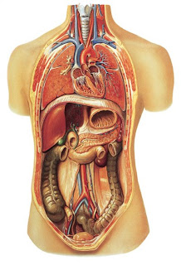
Internal Organs
Injuries

Slide 2
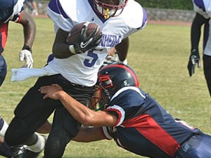
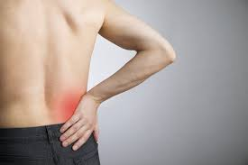
Kidney
Mechanism- hit to back
Symptoms- lower back pain,
pain down leg, hematuria
Check Vital Signs
TX- CT scan and Ultra sound, and Possible surgery
https://books.google.com/books?id=go6WAgAAQBAJ&pg=PA114&lpg=PA114&dq=internal+organ+injuries+to+athletes&source=bl&ots=P4s9oai0fb&sig=pcbSBf8G2ezVDiolv1mMCjwtQ-0&hl=en&sa=X&ved=0ahUKEwjh077w973MAhVKbj4KHTJ3AywQ6AEIQTAF#v=onepage&q=internal%20organ%20injuries%20to%20athletes&f=false

Slide 3
Spleen
Mechanism- trauma/hit to body
Symptom- Kehr Sign, vital signs
TX- monitor in ICU, no contact (heals at first only on outside of organ so easy to break again), possible surgery- could rupture (splenectomy)
Mononucleosis- inflammed Spleen- susceptible to
injury
https://static-content.springer.com/image/prt%3A978-3-642-00418-%2F19/MediaObjects/978-3-642-00418-6_19_Part_Fig1-517_HTML.gif

Slide 4
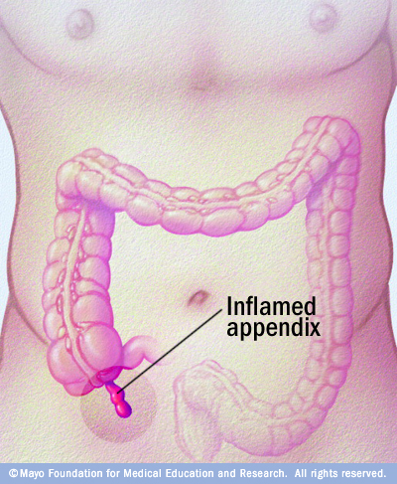
Appendix
Mechanism- block to appendix
Symptoms- severe lower right abdominal pain, positive rebound sign
If ruptures- life threatening,
appendectomy
and clean abdominal cavity

Slide 5
Liver
Mechanism- trauma to abdomen
Symptom-Right Abdominal Pain and right shoulder pain, nausea, blood in vomit, feces or urine
TX- operative or non-operative

Slide 6
Internal Bleeding
Cold sweaty skin
Signs of shock
Rigid stomach
Rapid pulse
Low Blood Pressure
http://www.foxnews.com/health/2013/08/30/death-high-school-football-player-leads-to-fight-for-internal-injury-awareness.html

